Slide 1

PRAಯಾS: Prison Rehabilitation & Assessment using AI for Support
An ethical AI system that alerts prison staff to early signs of distress or violence using existing prison data, flags risk levels, and supports rehabilitation through timely human decisions.

Slide 2

Problem Statement & Solution
Problem Statement
Proposed Solution
India’s overcrowded prison system, housing over 5.3 lakh inmates across 1,300+ facilities, faces persistent challenges of inmate violence and unaddressed psychological distress.
Official data shows that violent clashes inside prisons are frequent, with several states reporting dozens of incidents annually, pointing to serious safety gaps. At the same time, suicide accounts for a majority of unnatural deaths in Indian prisons, with inmate suicide rates more than twice that of the general population, reflecting deep unmet mental health needs.
These issues persist because prison monitoring remains largely reactive, responding only after incidents occur. Without tools to detect early behavioral warning signs, opportunities for prevention, de-escalation, and meaningful rehabilitation are missed undermining the core purpose of correctional systems.
PRAಯಾS is a system that helps prison staff notice early signs of depression or violent behaviour among inmates. It looks at changes in behaviour such as movement, routine, and visible emotional cues using existing cameras and records, without storing personal identity.
Based on these changes, the system classifies risk into priority levels (low, medium, high) and suggests a personalized plan of action, such as counselling, routine changes, or medical attention. At the same time, PRAಯಾS tracks good and stable behavior and shows it on a dashboard to support rehabilitation and parole or bail review. All decisions are made by humans. The system only helps by giving alerts and suggestions

Slide 3
Technical Approach
The system operates in four layers:
01
02
Data Collection
Affective Computing Layer
Prisoner profile summaries (case type, sentence stage, wellbeing flags)
Extracts emotion‑related features such as:
Routine and activity logs
facial action units (micro‑expressions)
CCTV video streams , which already exists as part of prison infrastructure.(processed in real time, no storage of identities)
body posture
agitation and pacing frequency
Focuses on emotional state indicators, not diagnosis
03
04
Behavioral Analysis Layer
Decision Support Layer
Establishes an individual baseline
Detects signs of depression or possible violence
Detects deviations over time
Explains alerts in clear, simple language
Combines emotional + behavioral signals
Suggests a personalized action plan (counseling, routine change, monitoring, medical review)
Shows risk levels, behavior trends, and positive progress on a behavior dashboard
Ensures all alerts and actions are reviewed and approved by prison staff

Slide 4

Affective Computing & ML Model
PRAಯಾS uses affective computing to recognize observable emotional cues, not to label or judge inmates.
ML Model Training Approach:
Output
Input features:
Emotional state bands: stable / elevated / high‑risk
Facial expression embeddings (stress, neutrality, agitation indicators)
Confidence score
Explanation of contributing signals.
Body movement intensity
Behavioural dashboard
Duration of inactivity or isolation
Personalized plan of action to deescalate the situation for each of the involved parties.
Training data:
Publicly available emotion datasets (e.g., stress / neutral / agitation)
⚠️ The model does not diagnose mental health conditions.
Simulated and anonymized data
Model type:
CNN‑based feature extraction
Classification into emotional intensity levels, not emotions

Slide 5
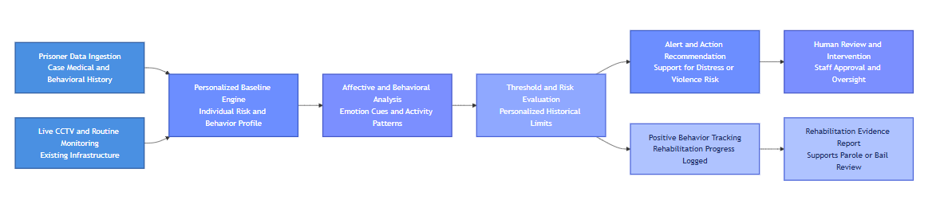
Implementation of PRAಯಾS

Slide 6
Google Technologies Used
Google Tech Stack
Google Gemini (Vertex AI)
Google Cloud Vision API
Firebase
Converts model outputs into explainable summaries
Extracts facial and body‑movement features
Firestore: prisoner profiles, behavior logs, alerts
Generates supportive, non‑medical intervention suggestions
No identity recognition or biometric storage
Authentication: role‑based access (warden, counselor)
Cloud Functions
BigQuery
Looker Studio
Threshold logic and alert escalation
Anonymous trend analysis
Visualization of trends using dashboards and flowcharts
Institution‑level dashboards

Slide 7

Feasibility & Viability
Technical Feasibility
Operational Viability
Ethical Safeguards
Uses existing CCTV infrastructure
Works as an overlay, not a replacement
No biometric identity storage
ML models trained on public datasets
No automated punishment or parole
Minimal staff retraining
Real‑time processing achievable at pilot scale
Scalable from single prison to state level
Human‑in‑the‑loop mandatory
Privacy‑preserving analytics

Slide 8

Impacts & Benefits
Early detection of emotional distress
Improved rehabilitation tracking
Better workload prioritization for staff
Data‑driven but humane prison management

Slide 9

Conclusion
PRAಯಾS demonstrates how affective computing and responsible AI can be effectively applied in correctional systems to address two critical challenges: inmate wellbeing and prison violence. By combining emotional signal recognition, behavioural pattern analysis, and explainable AI, the system enables early risk detection and de-escalation, while ensuring that all decisions remain human-led.
In the Indian prison context, where overcrowding and limited mental health capacity strain rehabilitation efforts, PRAಯಾS offers a scalable, ethical support tool that works with existing infrastructure and respects privacy. At the same time, its design reflects challenges faced by correctional systems globally, making the approach adaptable across regions.
By shifting prisons from reactive surveillance to proactive care, PRAಯಾS shows how technology can strengthen safety, support rehabilitation, and align correctional practices with humane, data-driven governance.

